Slide 1
INSTRUCTIONS
Use Font size 22 to 28 and Font Style Times New Roman (body)
Do not change the Template: Heading / Title of the slides
Do not change font style or colours
Do not copy paste paragraphs: use only Bullet Points
Maximum slide Limit is 20 only
As per the number of supervisor allotted adopt slide-2 or slide-3
Please display the required meaningful Content or images or tables
Change the footer accordingly using insert tab then click on header & footer tab and edit it
Save the PPT with Register No, Dept and Review no, example: 23xxxxxxxxx_CSE

Slide 2

CALM THOUGHTS CREATE BEAUTIFUL OUTCOMES
STUDENT NAME: GEETHIKA CHOWDARY
STUDENT ID: 2520030354
CLUSTER: 3
SECTION: 11
Under the Guidance
of
Supervisor Name: DR.N.CHAITANYA KUMAR
Professor
Department of CSE

Slide 3
OUTLINE
Abstract
Existing System
Proposed System
System Architecture
Project Modules
Objectives
Co’s Attainments - FWD
Co1
Co2 …….. 5. Co5
Co’s Attainments - DSA
Co1
Co2 …….. 5. Co5
Screen Shots for FWD & DSA
Conclusion
Geo-Tagged Photos

Slide 4
ABSTRACT
The Calm Thoughts Create Beautiful Outcomes website is designed to provide a peaceful digital space that encourages emotional reflection, personal clarity, and positive growth. In today’s fast-paced world, many individuals experience stress, confusion, and emotional pressure. This platform aims to create a calm environment where users can slow down, reflect on their thoughts, and develop a healthier mindset.
The website includes sections such as Feel-Good Articles, Real-Life Scenarios, and a Comfort Writing Space where users can express their emotions freely. The platform encourages users to explore thoughtful content, learn how to respond to real-life situations calmly, and develop self-awareness through writing. The system is developed using HTML, CSS, and JavaScript, which provide the structure, visual design, and interactive features of the website. Animations, aesthetic design elements, and a user-friendly interface enhance the overall experience and make the platform welcoming and engaging.

Slide 5
EXISTING SYSTEM
Many people currently use social media platforms, blogs, and online forums to share their thoughts and emotions.
Some journaling and self-help applications provide spaces for writing personal experiences and reading motivational content.
Existing platforms mainly focus on entertainment, communication, or large community discussions rather than personal emotional reflection.
Users often face distractions such as advertisements, notifications, and unrelated content while using these platforms.
Many platforms do not provide a calm and structured environment specifically designed for mindful thinking and emotional clarity.

Slide 6
PROPOSED SYSTEM
The proposed system is a calm and user-friendly website designed to encourage positive thinking and emotional reflection.
The platform provides feel-good articles that help users develop a positive mindset and reduce stress.
It includes real-life scenarios that guide users on how to respond to everyday situations in a calm and thoughtful way.
The website offers a comfort writing space where users can freely express their thoughts and feelings.
A simple login system allows users to begin their personal journey on the platform.
The website design focuses on aesthetic visuals, smooth animations, and a peaceful color theme to create a relaxing environment.

Slide 7
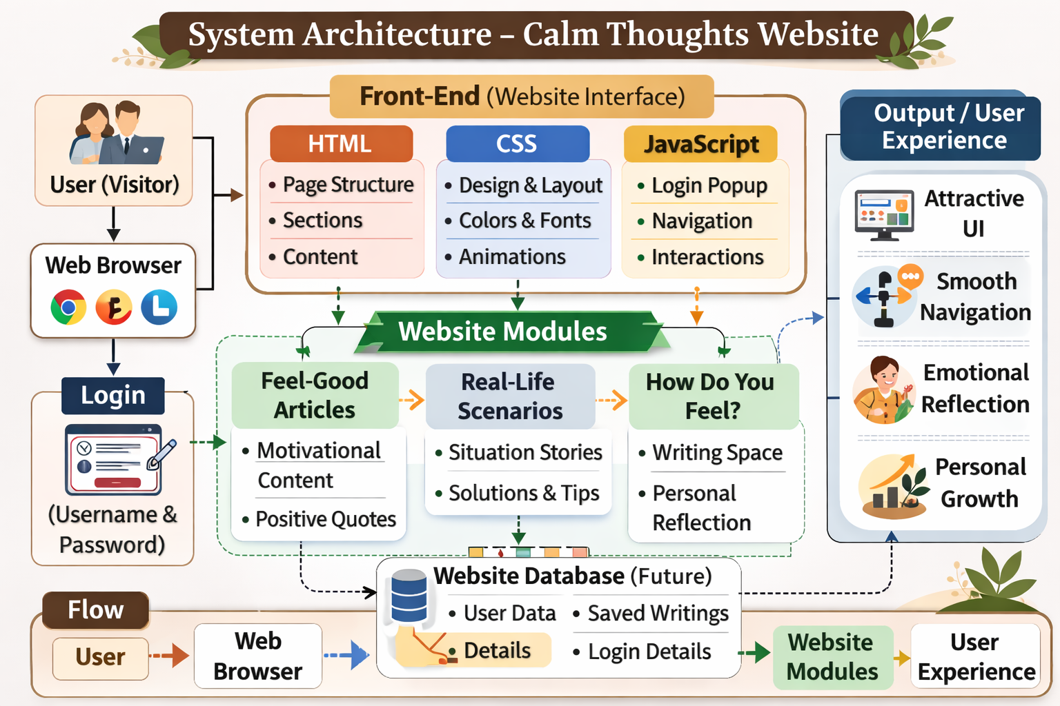
SYSTEM ARCHITECTURE

Slide 8
PROJECT MODULES
User Interface Module – Provides the visual design of the website with calm colors, layout, and navigation for a smooth user experience.
User Login Module – Allows users to create a username and password and begin their journey on the website.
Feel-Good Articles Module – Displays motivational and positive articles to encourage calm thinking and a positive mindset.
Real-Life Scenarios Module – Presents real-life situations and guidance to help users respond thoughtfully and calmly.
Emotional Reflection Module – Provides a writing space where users can express their thoughts and feelings freely.

Slide 9
OBJECTIVES
To create a calm and positive digital space where users can relax and reflect on their thoughts.
To encourage positive thinking and mental clarity through motivational articles and meaningful content.
To help users understand real-life situations and respond to them in a calm and thoughtful way.
To provide a safe space for emotional expression where users can write and share how they feel.
To promote personal growth and self-awareness by encouraging reflection and mindful thinking.
To provide a user-friendly and aesthetic interface that creates a peaceful browsing experience.
To reduce stress and overthinking by offering calming content and reflection activities.

Slide 10
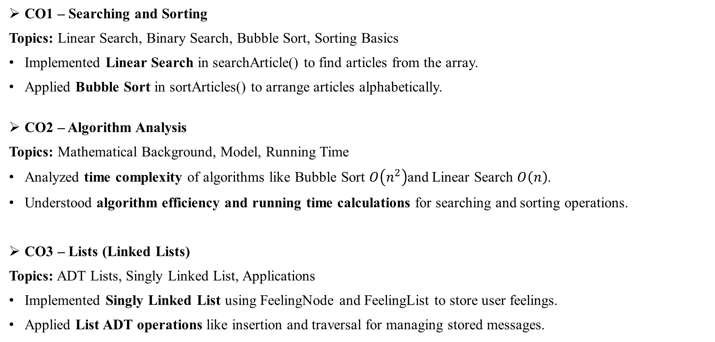
CO’s ATTAINMENT - DSA
CO1 – Searching and Sorting
Topics: Linear Search, Binary Search, Bubble Sort, Sorting Basics
Implemented Linear Search in searchArticle() to find articles from the array.
Applied Bubble Sort in sortArticles() to arrange articles alphabetically.
CO2 – Algorithm Analysis
Topics: Mathematical Background, Model, Running Time
Analyzed time complexity of algorithms like Bubble Sort $O\left(n^{2}\right)$and Linear Search $O\left(n\right)$.
Understood algorithm efficiency and running time calculations for searching and sorting operations.
CO3 – Lists (Linked Lists)
Topics: ADT Lists, Singly Linked List, Applications
Implemented Singly Linked List using FeelingNode and FeelingList to store user feelings.
Applied List ADT operations like insertion and traversal for managing stored messages.

Slide 11
CO4 – Stacks and Queues
Topics: Stack ADT, Queue ADT, Operations
Used Stack data structure (ActionStack) to store and display recent user actions.
Implemented Queue using LinkedList (ArticleQueue) to manage article requests in FIFO order.
CO5 – Hashing and Trees
Topics: Hash Functions, Hash Tables, Priority Queues
Used HashMap in UserDatabase for efficient user storage and authentication.
Applied hash-based searching for quick login validation and user retrieval.

Slide 12
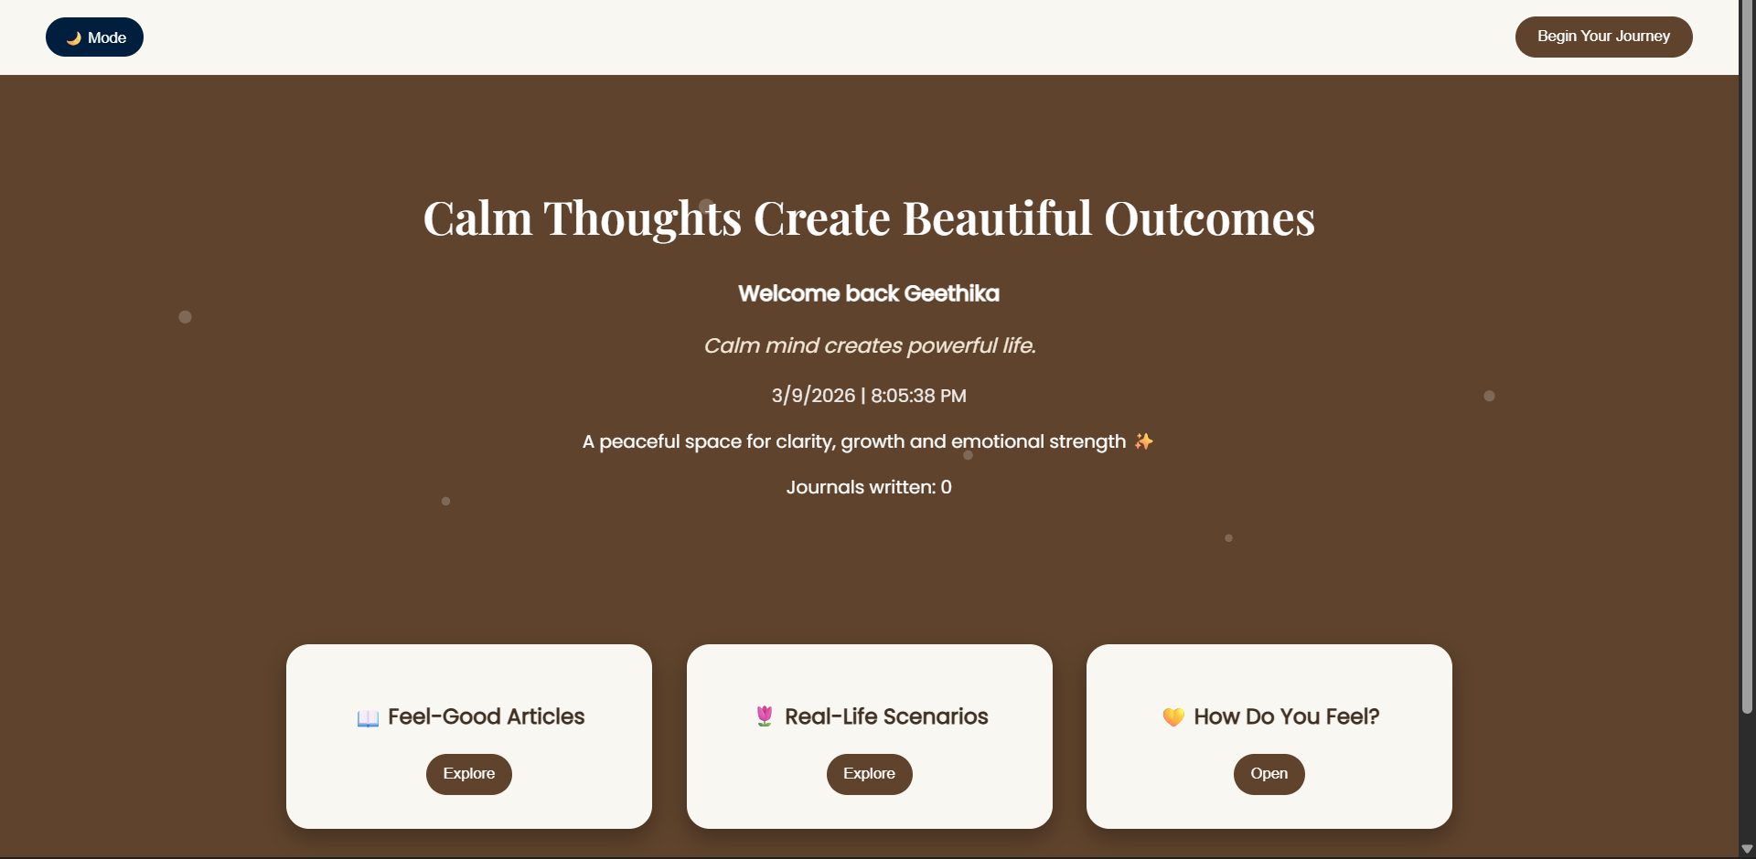
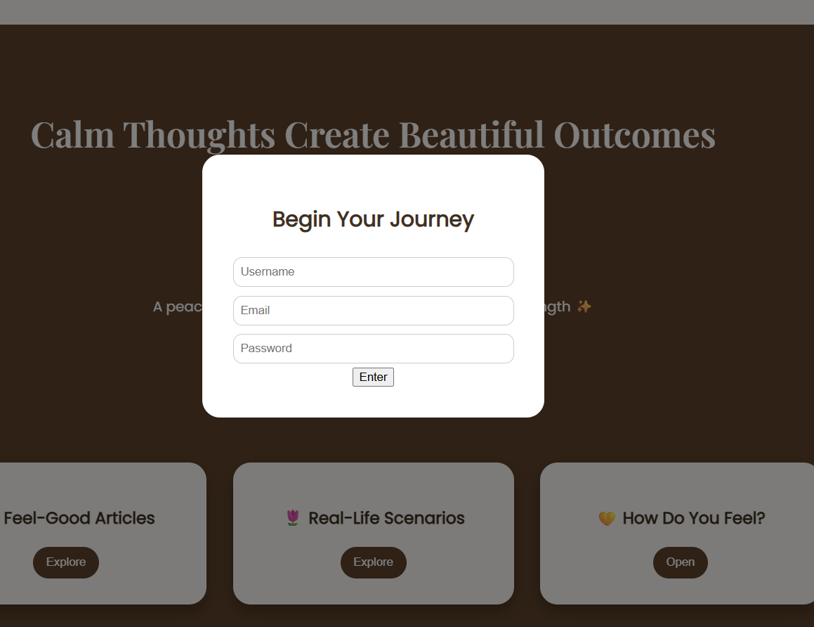
SCREENSHOTS FOR DSA

Slide 13
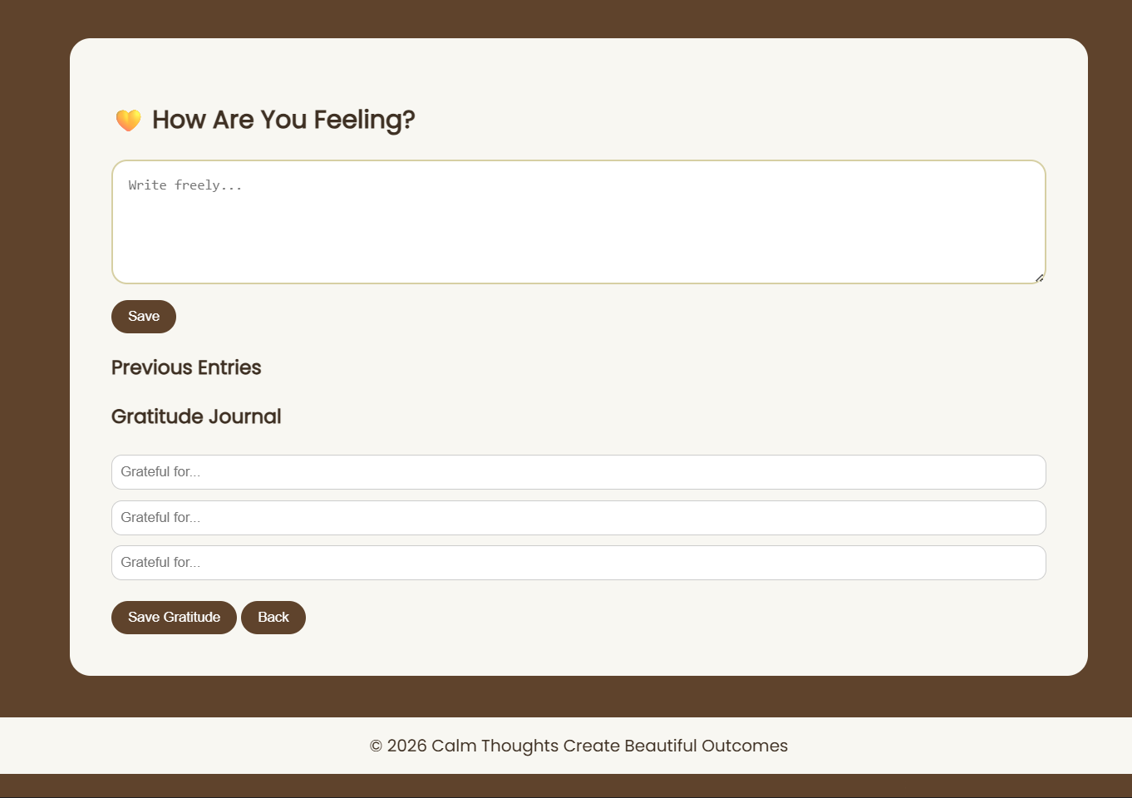
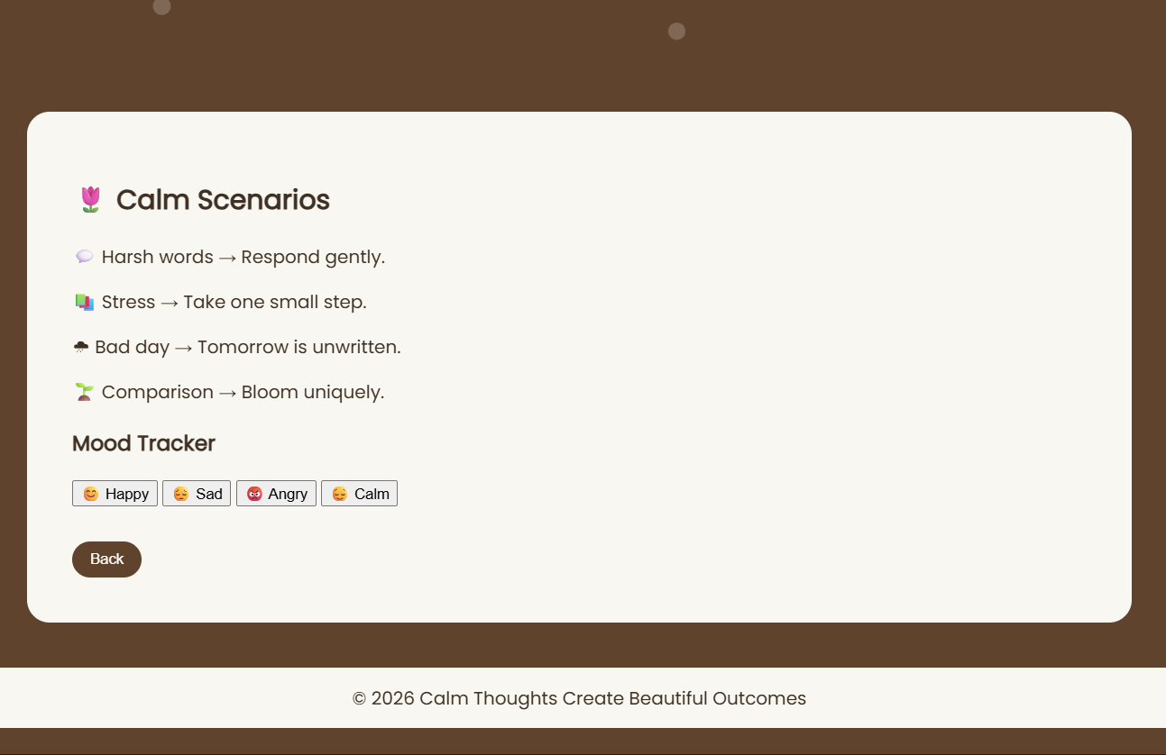
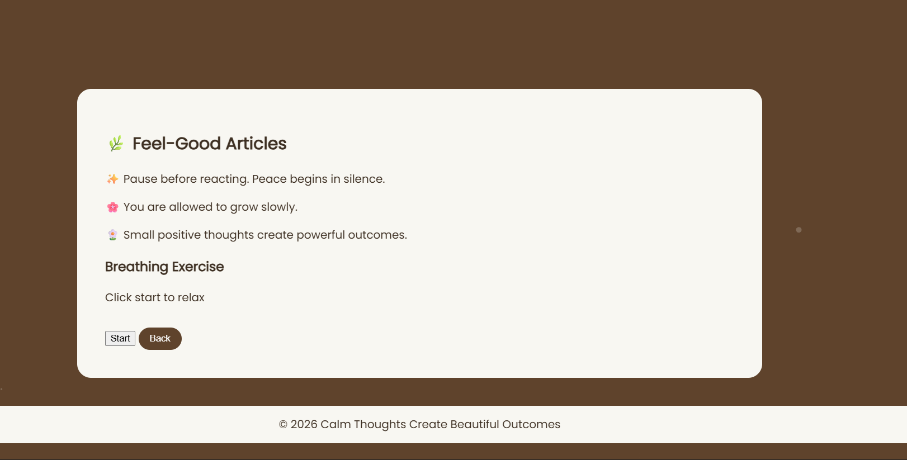

Slide 14
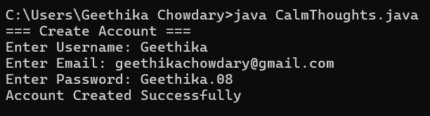
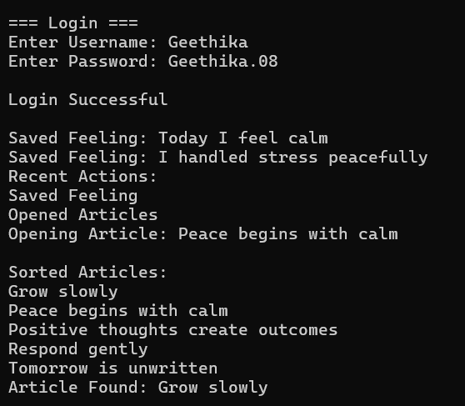

Slide 15
CONCLUSION
The Calm Thoughts Create Beautiful Outcomes website is designed to create a peaceful digital environment that encourages positive thinking, emotional reflection, and personal growth. The platform provides motivational articles, real-life scenarios, and a personal writing space where users can express their thoughts and feelings freely.
By using HTML, CSS, and JavaScript, the website offers a simple, aesthetic, and interactive interface that makes the user experience comfortable and engaging. The calm design, smooth navigation, and meaningful content help users develop mental clarity, self-awareness, and a positive mindset . Overall, the project demonstrates how a well-designed web platform can support emotional well-being, mindfulness, and self-expression, helping users transform calm thoughts into beautiful outcomes.

Slide 16
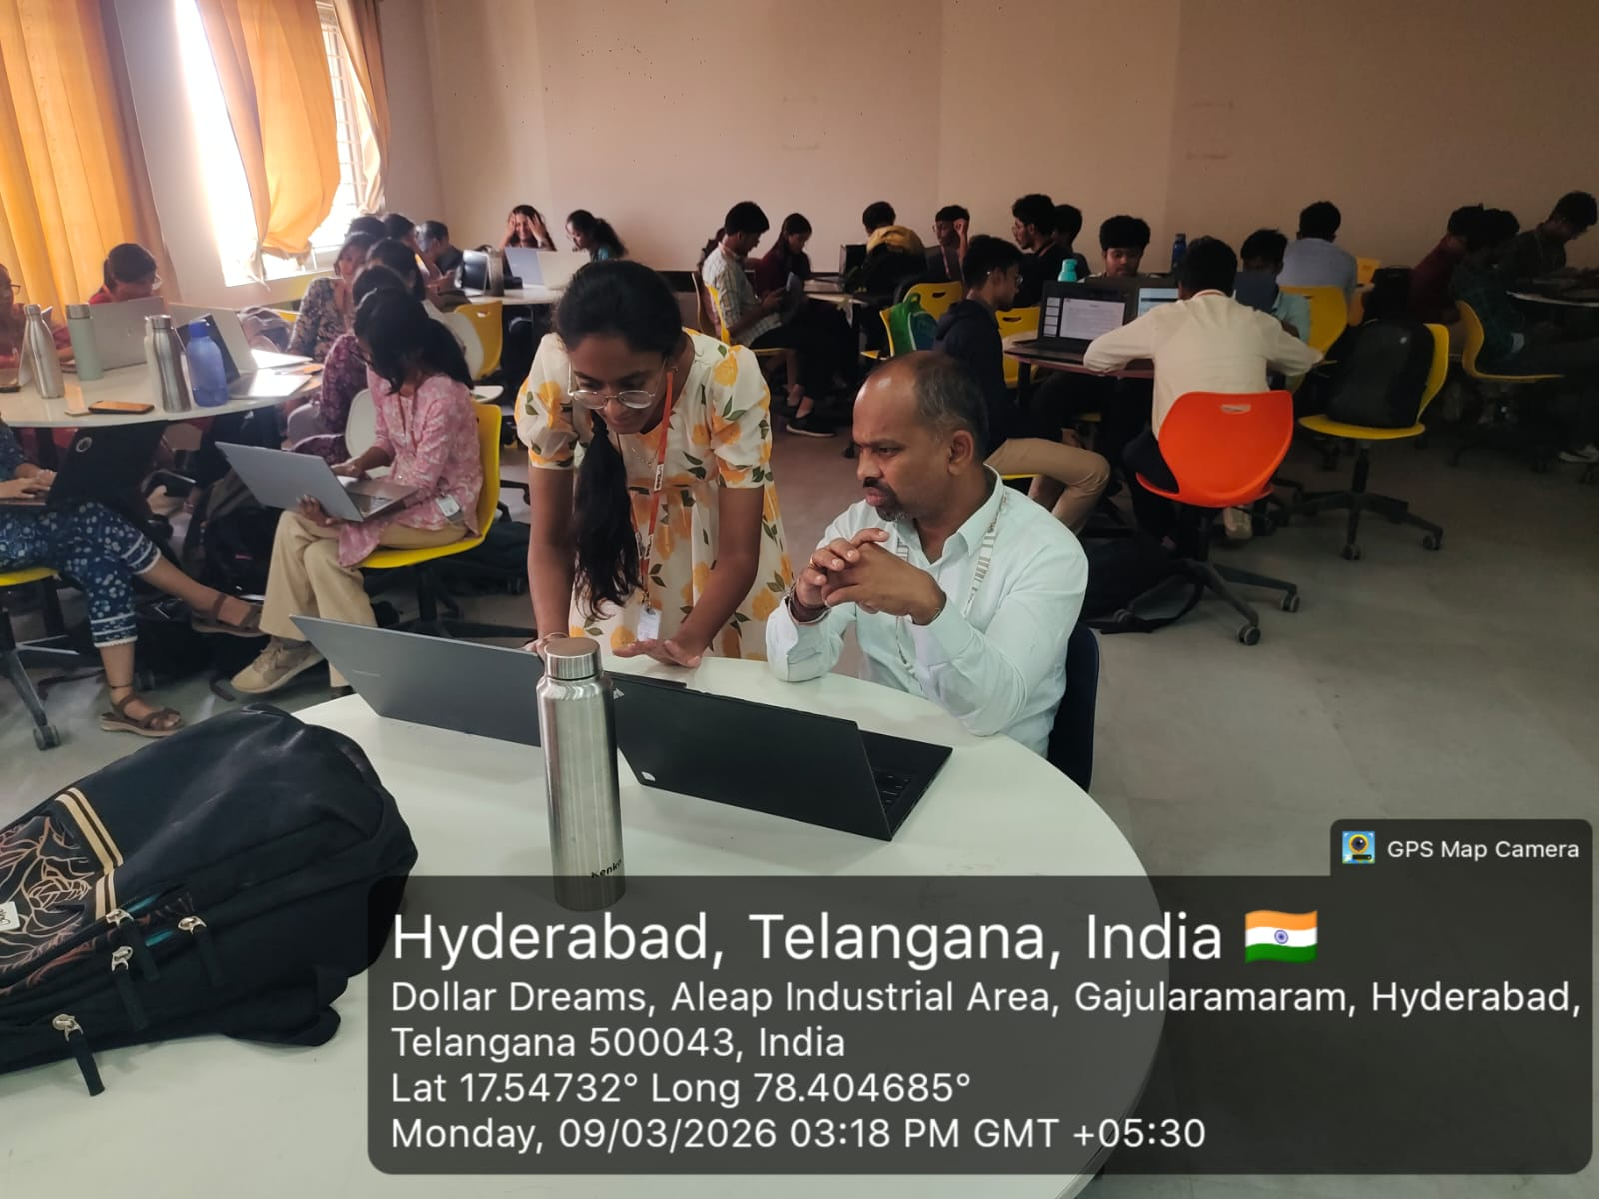
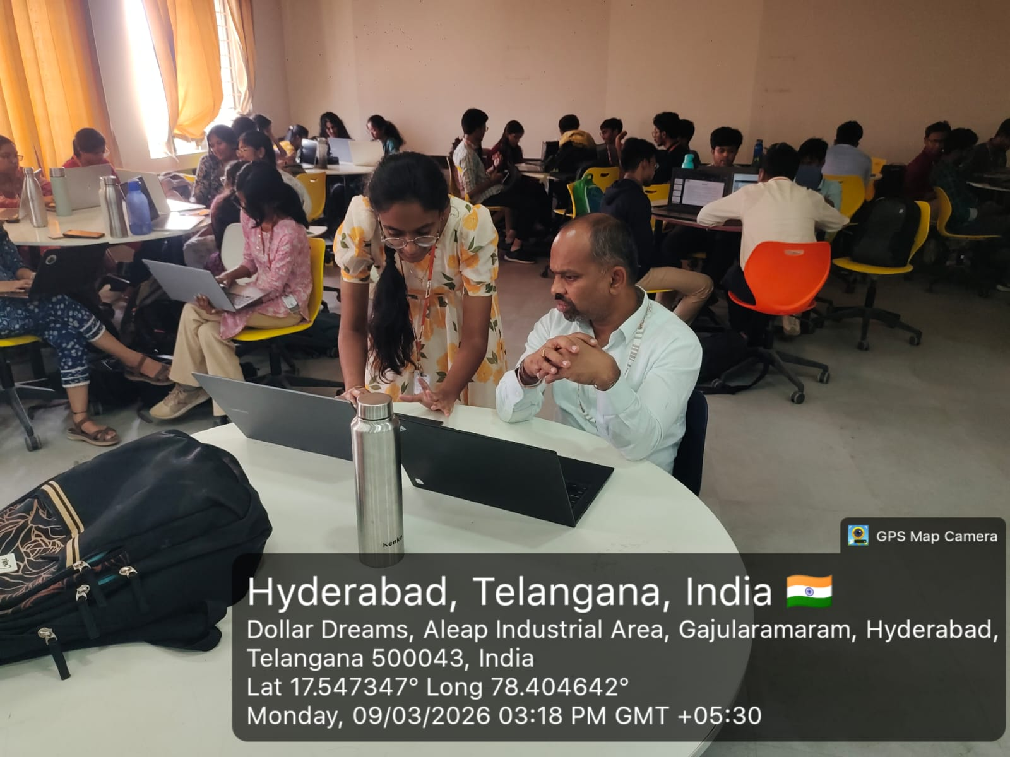
GEO-TAG PHOTOS

Slide 17
THANK YOU

